Slide 1
Chapter 14: Transactions

Slide 2
Chapter 14: Transactions
Transaction Concept
Transaction State
Concurrent Executions
Serializability
Recoverability
Implementation of Isolation
Transaction Definition in SQL
Testing for Serializability.

Slide 3
Transactions
A series of one or more SQL statements that are logically related are termed as a Transaction.
E.g:
transaction to transfer $50 from account A to account B:
  1. read(A)
  2. A := A – 50
  3. write(A)
  4. read(B)
  5. B := B + 50
  6. write(B)
Notes:
Read(A) and Write(A), reads and writes to the Main memory To/from the Transactions’ local memory.
Actual bank transaction involves 2 commands: update set balance = balance -500 where Acc_id =A followed by update set balance = balance +500 where Acc_id =B

Slide 4
A transaction is a unit of program execution that accesses and possibly updates various data items. Usually, a transaction is initiated by a user program written in a high-level data-manipulation language
A transaction is delimited by statements (or function calls) of the form begin transaction and end transaction. The transaction consists of all operations executed between the begin transaction and end transaction.
This collection of steps must appear to the user as a single, indivisible unit. This “all-or-none” property is referred to as atomicity.

Slide 5
the database system must take special actions to ensure that transactions operate properly without interference from concurrently executing database statements. This property is referred to as isolation.
Even if the system ensures correct execution of a transaction, this serves little purpose if the system subsequently crashes and, as a result, the system “forgets” about the transaction. Thus, a transaction’s actions must persist across crashes. This property is referred to as durability.
if a transaction is run atomically in isolation starting from a consistent database, the database must again be consistent at the end of the transaction. This property is referred to as consistency.

Slide 6
ACID Properties
we require that the database system maintain the following properties of the transactions:
Atomicity. Either all operations of the transaction are properly reflected in the database or none are.
Consistency. Execution of a transaction in isolation preserves the consistency of the database.
Isolation. Although multiple transactions may execute concurrently, each transaction must be unaware of other concurrently executing transactions. Intermediate transaction results must be hidden from other concurrently executed transactions.
  That is, for every pair of transactions T_{i} and T_{j}, it appears to T_{i} that either T_{j}, finished execution before T_{i} started, or T_{j} started execution after T_{i} finished.
Durability. After a transaction completes successfully, the changes it has made to the database persist, even if there are system failures.
Notes:
Atomic: Irreducible unit.
Must be unware means there should not be any dependency among the transaction operations.
Atomicity--→ Recovery system
Consistency→ Application programmer
Durability→ Recovery system
Isolation→ concurrency-control system,

Slide 7
Example of Fund Transfer
Transaction to transfer $50 from account A to account B:
  1. read(A)
  2. A := A – 50
  3. write(A)
  4. read(B)
  5. B := B + 50
  write(B)
Atomicity requirement
  if the transaction fails after step 3 and before step 6, money will be “lost” leading to an inconsistent database state
    Failure could be due to software(R.Error in Query) or hardware(S/W crash)
  the system should ensure that updates of a partially executed transaction are not reflected in the database
Durability requirement — once the user has been notified that the transaction has completed (i.e., the transfer of the $50 has taken place), the updates to the database by the transaction must persist even if there are software or hardware failures.

Slide 8
Example of Fund Transfer (Cont.)
Transaction to transfer $50 from account A to account B:
  1. read(A)
  2. A := A – 50
  3. write(A)
  4. read(B)
  5. B := B + 50
  6. write(B)
Consistency requirement in above example:
  the sum of A and B is unchanged by the execution of the transaction
In general, consistency requirements include
    Explicitly specified integrity constraints such as primary keys and foreign keys
    Implicit integrity constraints
      e.g. sum of balances of all accounts, minus sum of loan amounts must equal value of cash-in-hand
  A transaction must see a consistent database.
  During transaction execution the database may be temporarily inconsistent.
  When the transaction completes successfully the database must be consistent
    Erroneous transaction logic can lead to inconsistency
Notes:
Consider T1 which subtracts 50 from A and adds it to B, initial A is 100
T2 which credits 100 to A. i.e read(A) ; A := A + 100 ; write(A)
If T1 and T2 are executed separately with the order of execution
like <T1, T2> then A’s value will be 100, 50 (100-50), 150 (50+100) or
If the order of execution is <T2, T1> then 100, 200 (100+100), 150 (200-50)
Here both execution order preserves the A’s value, i.e it leaves the A in consistency state.
Suppose T1 and T2 operations are interleaved then, eg: T1 reads A as 100, T2 also reads A as 100, T1 updates it as 50, T2 updates As 200, then final A is 200, which is inconsistency.
Here T2 suppose to execute wither before T1 readsA or After T1 wtires A. But neither of theses things are happening which results into inconsistent state.
In previous step if Ts execution are isolated then it would have resulted into consistent state.

Slide 9
Example of Fund Transfer (Cont.)
Isolation requirement — if between steps 3 and 6, another transaction T2 is allowed to access the partially updated database, it will see an inconsistent database (the sum A + B will be less than it should be).
T1 T2
  1. read(A)
  2. A := A – 50
  3. write(A)
  read(A), read(B), print(A+B)
  4. read(B)
  5. B := B + 50
  6. write(B)
Isolation can be ensured trivially by running transactions serially
  that is, one after the other.
However, executing multiple transactions concurrently has significant benefits, as we will see later.

Slide 10
Storage Structure
To understand how to ensure the atomicity and durability properties of a transaction, we must gain a better understanding of how the various data items in the database may be stored and accessed.
Volatile storage: Information residing in volatile storage does not usually survive system crashes. Examples: main memory and cache memory.
Nonvolatile storage: Information residing in nonvolatile storage survives system crashes. Ex: secondary storage devices such as magnetic disk and flash storage, used for online storage, and tertiary storage devices such as optical media, and magnetic tapes, used for archival storage.
Stable storage: Information residing in stable storage is never lost. Extremely unlikely to lose data- replicate information

Slide 11
For a transaction to be durable, its changes need to be written to stable storage.
Similarly, for a transaction to be atomic, log records need to be written to stable storage before any changes are made to the database on disk.
Clearly, the degree to which a system ensures durability and atomicity depends on how stable its implementation of stable storage really is.

Slide 12
Transaction Atomicity and Durability
A transaction may not always complete its execution successfully. Such a transaction is termed as aborted.
Once the changes caused by an aborted transaction have been undone, we say that the transaction has been rolled back.
It is part of the responsibility of the recovery scheme to manage transaction aborts. This is done typically by maintaining a log.
Maintaining a log provides the possibility of redoing a modification to ensure atomicity and durability as well as the possibility of undoing a modification to ensure atomicity in case of a failure during transaction execution.
A transaction that completes its execution successfully is said to be committed. The only way to undo the effects of a committed transaction is to execute a compensating transaction.

Slide 13
Transaction State
Active – the initial state; the transaction stays in this state while it is executing
Partially committed – after the final statement has been executed.
Failed -- after the discovery that normal execution can no longer proceed.
Aborted – after the transaction has been rolled back and the database restored to its state prior to the start of the transaction. Two options after it has been aborted:
  restart the transaction
    can be done only if no internal logical error
  kill the transaction
Committed – after successful completion.
Notes:
Once a transaction has committed, we cannot undo its effects by aborting it. The only way to undo the effects of a committed transaction is to execute a
compensating transaction. For instance, if a transaction added $20 to an account, the compensating transaction would subtract $20 from the account.

Slide 14

Transaction model

Slide 15
Transaction State (Cont.)
The system has two options if the transaction is failed:
It can restart the transaction, but only if the transaction was aborted as a result of some hardware or software error that was not created through the internal logic of the transaction.
A restarted transaction is considered to be a new transaction.
It can kill the transaction. It usually does so because of some internal logical error that can be corrected only by rewriting the application program, or because the input was bad, or because the desired data were not found in the database.

Slide 16
Transaction Concept
COMMIT and ROLLBACK commands
A transaction begins with the first executable SQL statement after a commit, rollback or connection made to the database.
A transaction can be closed by using a commit or a rollback statement.
COMMIT ends the current transaction and makes permanent changes made during the transaction
ROLLBACK ends the transaction but undoes any changes made during the transaction
Syntax: COMMIT; ROLLBACK ;

Slide 17
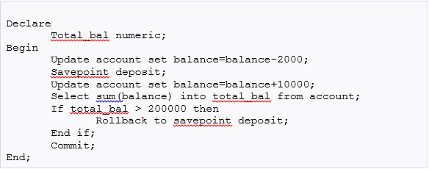
Example for usage of Commit, Rollback and SAVEPOINT
Withdraw an amount 2,000 and deposit 10,000 for all the accounts. If the sum of balance of all accounts exceeds 2,00,000 then undo the deposit just made.
SAVEPOINT marks and saves the current point in the processing of a transaction. When a savepoint is used with a ROLLBACK statement, parts of transaction can be undone.

Slide 18
Transaction isolation
Ensuring consistency in spite of concurrent execution of transactions requires extra work; it is far easier to insist that transactions run serially—that is, one at a time, each starting only after the previous one has completed.
Multiple transactions are allowed to run concurrently in the system. Advantages are:
  increased processor and disk utilization, leading to better transaction throughput
    E.g. one transaction can be using the CPU while another is reading from or writing to the disk
  reduced average response time/waiting time for transactions: short transactions need not wait behind long ones.
Concurrency control schemes – mechanisms to achieve isolation
  that is, to control the interaction among the concurrent transactions in order to prevent them from destroying the consistency of the database.

Slide 19
Why Concurrency Control is needed
Problems occur when concurrent transactions execute in an uncontrolled manner:
  The Lost Update
  The Temporary Update (or Dirty Read)
  The Incorrect Summary
  Unrepeatable Read:
    A transaction T1 may read a given value. If another transaction later updates that value and T1 reads that value again, then T1 will see a different value.

Slide 20
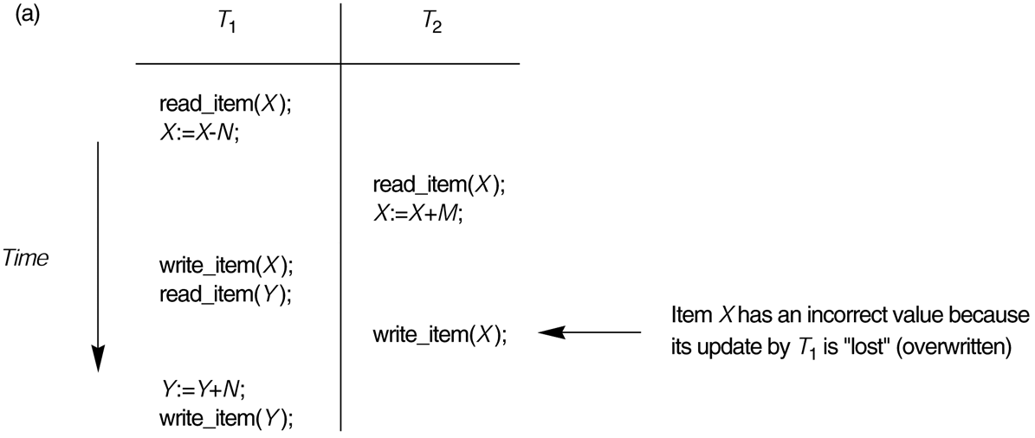
The Lost Update Problem
This occurs when two transactions that access the same database items have their operations interleaved in a way that makes the value of some database item incorrect.

Slide 21
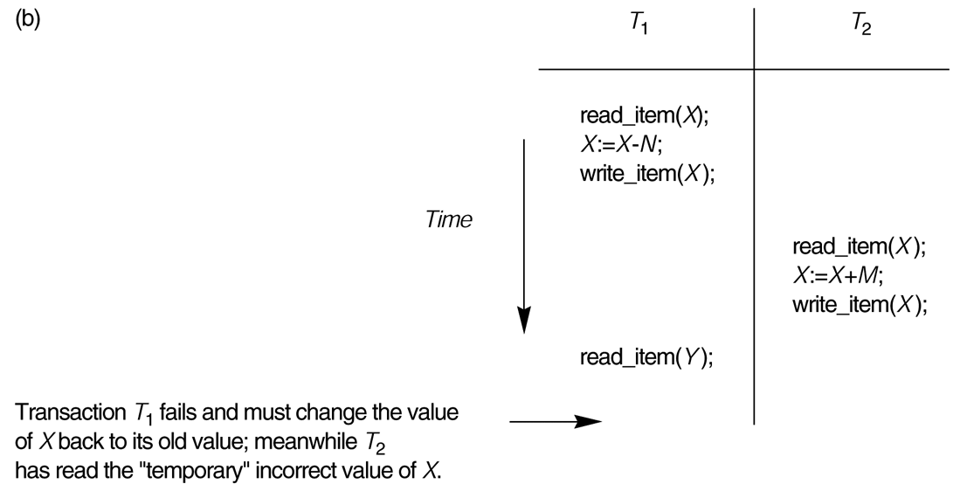
The Temporary Update Problem
(Dirty Read)
This occurs when one transaction updates a database item and then the transaction fails for some reason.
  The updated item is accessed by another transaction before it is changed back to its original value.

Slide 22
Incorrect Summary Problem
If one transaction is calculating an aggregate summary function on a number of records while other transactions are updating some of these records, the aggregate function may calculate some values before they are updated and others after they are updated.

Slide 23
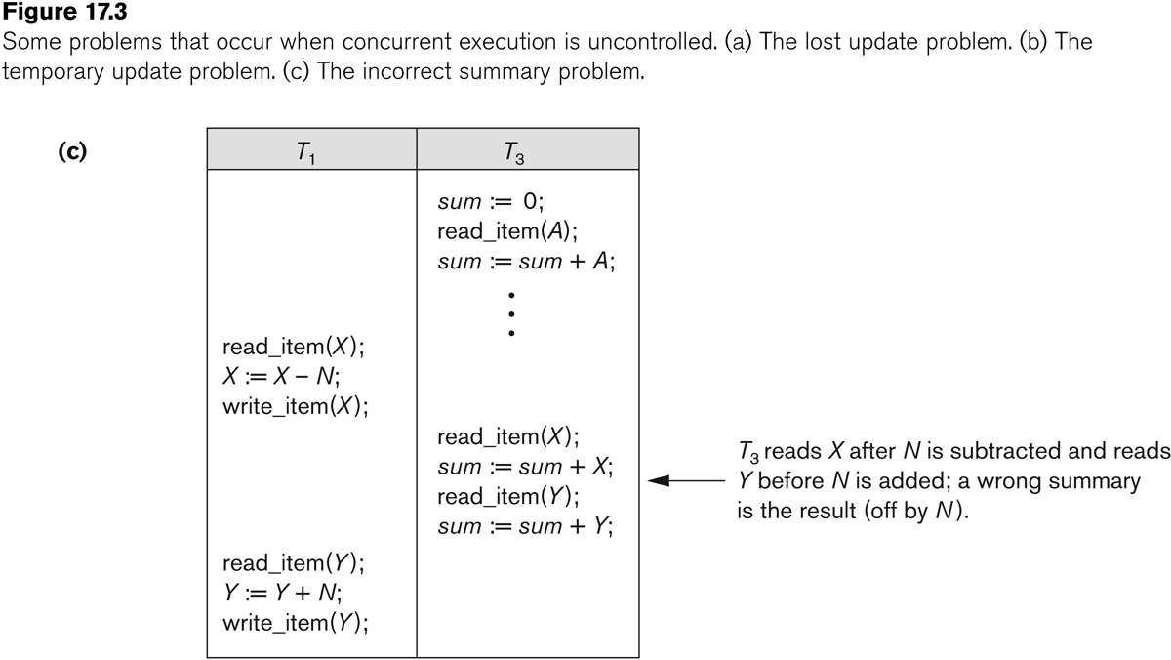
Incorrect Summary Problem

Slide 24
Schedules
Schedule – a sequences of instructions that specify the chronological order in which instructions of concurrent transactions are executed
  a schedule for a set of transactions must consist of all instructions of those transactions
  must preserve the order in which the instructions appear in each individual transaction.
A transaction that successfully completes its execution will have a commit instructions as the last statement
  by default transaction assumed to execute commit instruction as its last step
A transaction that fails to successfully complete its execution will have an abort instruction as the last statement
Notes:
Schedule is a set of sequence of operations withing a given span of time. The schedule will include operations from multiple Ts.

Slide 25
Schedules
A schedule S of n transactions T₁, T₂, ..., T_{n} is an ordering of all the operations in these transactions subject to the constraint that:
  for each transaction T_{i}, the operations of T_{i} in S must appear in the same order as they do in T_{i}.
    Note, however, that operations from other transactions T_{j} can be interleaved with the operations of T_{i} in S.
Example: Given
  T₁ = R₁(Q) W₁(Q) & T₂ = R₂(Q) W₂(Q)
  a schedule: R₁(Q) R₂(Q) W₁(Q) W₂(Q)
  not a schedule: W₁(Q) R₁(Q) R₂(Q) W₂(Q)

Slide 26
Schedules
S_{a}: r₁(X); r₂(X); w₁(X); r₁(Y); w₂(X); w₁(Y);

Slide 27
Schedules
S_{b}: r₁(X); w₁(X); r₂(X); w₂(X); r₁(Y); a₁;

Slide 28

Schedule 1
Let T₁ transfer $50 from A to B, and T₂ transfer 10% of the balance from A to B.
A serial schedule in which T₁ is followed by T₂ :

Slide 29

Schedule 2
A serial schedule where T₂ is followed by T₁

Slide 30

Schedule 3
Let T₁ and T₂ be the transactions defined previously. The following schedule is not a serial schedule (It is CONCURRENT Schedule),
but it is equivalent to Schedule 1.
In Schedules 1, 2 and 3, the sum A + B is preserved.

Slide 31

Schedule 4
The following concurrent schedule does not preserve the value of (A + B ). It has Lost Update problems.

Slide 32
We can ensure consistency of the database under concurrent execution by making sure that any schedule that is executed has the same effect as a schedule that could have occurred without any concurrent execution.
That is, the schedule should, in some sense, be equivalent to a serial schedule. Such schedules are called serializable schedules.
serial schedules are serializable, but if steps of multiple transactions are interleaved, it is harder to determine whether a schedule is serializable.
Since transactions are programs, it is difficult to determine exactly what operations a transaction performs and how operations of various transactions interact.
For this reason, we shall not consider the various types of operations that a transaction can perform on a data item, but instead consider only two operations: read and write.

Slide 33
Serializability
Basic Assumption – Each transaction preserves database consistency.
Thus serial execution of a set of transactions preserves database consistency.
A concurrent schedule is serializable if it is equivalent to a serial schedule.
  1. conflict serializability
  2. view serializability
Notes:
To check the Validity of the Schedule we use Schedule Serialization concept.
Schedule is valid or serializable means it leaves the database in consistent state.
How to check schedule is serializable or not ?

Slide 34
Simplified view of transactions
  We ignore operations other than read and write instructions
  We assume that transactions may perform arbitrary computations on data in local buffers in between reads and writes.
  Our simplified schedules consist of only read and write instructions.

Slide 35
In this section, we discuss different forms of schedule equivalence, but focus on a particular form called conflict serializability.
Let us consider a schedule S in which there are two consecutive instructions, I and J , of transactions Ti and Tj , respectively (i ≠ j).
there are four cases that we need to consider
I = read(Q), J = read(Q). The order of I and J does not matter, since the same value of Q is read by Ti and Tj , regardless of the order.
I = read(Q), J = write(Q). If I comes before J , then Ti does not read the value of Q that is written by Tj in instruction J . If J comes before I, then Ti reads the value of Q that is written by Tj. Thus, the order of I and J matters.

Slide 36
I = write(Q), J = read(Q). The order of I and J matters for reasons similar
to those of the previous case.
4. I = write(Q), J = write(Q). Since both instructions are write operations, the order of these instructions does not affect either Ti or Tj .
However, the value obtained by the next read(Q) instruction of S is affected, since the result of only the latter of the two write instructions is preserved in the database. If there is no other write(Q) instruction after I and J in S, then the order of I and J directly affects the final value of Q in the database state that results from schedule S.

Slide 37
We say that I and J conflict if they are operations by different transactions on the same data item, and at least one of these instructions is a write operation.

Slide 38
Conflict Serializability
Conflicting Instructions
Instructions l_{i} and l_{j} of transactions T_{i} and T_{j} respectively, conflict if and only if there exists some item Q accessed by both l_{i} and l_{j}, and at least one of these instructions wrote Q.
1. l_{i} = read(Q), l_{j} = read(Q). l_{i} and l_{j} don’t conflict.
2. l_{i} = read(Q), l_{j} = write(Q). They conflict.
3. l_{i} = write(Q), l_{j} = read(Q). They conflict
4. l_{i} = write(Q), l_{j} = write(Q). They conflict
Intuitively, a conflict between l_{i} and l_{j} forces a (logical) temporal order between them.
  If l_{i} and l_{j} are consecutive in a schedule and they do not conflict, their results would remain the same even if they had been interchanged in the schedule.

Slide 39
Conflict Serializability
If a schedule S can be transformed into a schedule S’ by a series of swaps of non-conflicting instructions, we say that S and S’ are conflict equivalent.
We say that a schedule S is conflict Serializable
if it is conflict equivalent to a serial schedule

Slide 40


Conflict Serializability (Cont.)
Schedule 3 can be transformed into Schedule 6, a serial schedule where T₂ follows T₁, by series of swaps of non-conflicting instructions.
Therefore Schedule 3 is conflict serializable.
Schedule 3
Schedule 6

Slide 41

Conflict Serializability (Cont.)
Example of a schedule that is not conflict serializable:
We are unable to swap instructions in the above schedule to obtain either the serial schedule < T₃, T₄ >, or the serial schedule < T₄, T₃ >.
Notes:
Eg is Not conflict serializable.
Here permutation of 3 that is 6 serial schedules are exist. And given concurrent schedule may be equal to at least one of them , to say that it is serializable.

Slide 42
Check Conflict Serializable, using Precedence Graph
We now present a simple and efficient method for determining conflict serializability of a schedule. Consider a schedule S. We construct a directed graph, called a precedence graph, fromS.
This graph consists of a pair G = (V, E), where V is a set of vertices and E is a set of edges. The set of vertices consists of all the transactions participating in the schedule. The set of edges consists of all edges
Ti →Tj for which one of three conditions holds:
1. Ti executes write(Q) before Tj executes read(Q).
2. Ti executes read(Q) before Tj executes write(Q).
3. Ti executes write(Q) before Tj executes write(Q).

Slide 43

Testing for Serializability
Consider some schedule of a set of transactions T₁, T₂, ..., T_{n}
Precedence graph — a directed graph where the vertices are the transactions (names).
We draw an arc from T_{i} to T_{j} if the two transaction conflict, and T_{i} accessed the data item on which the conflict arose earlier.
We may label the arc by the item that was accessed.
Example 1

Slide 44

Test for Conflict Serializability
A schedule is conflict serializable if and only if its precedence graph is acyclic.
Cycle-detection algorithms exist which take order n² time, where n is the number of vertices in the graph.
  (Better algorithms take order n + e where e is the number of edges.)
If precedence graph is acyclic, the serializability order can be obtained by a topological sorting of the graph.
  This is a linear order consistent with the partial order of the graph.
  For example, a serializability order for Schedule A would be
  T₅ → T₁ → T₃ → T₂ → T₄
    Are there others?

Slide 45
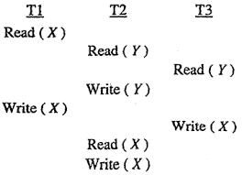

Slide 46
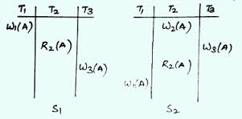

Slide 47
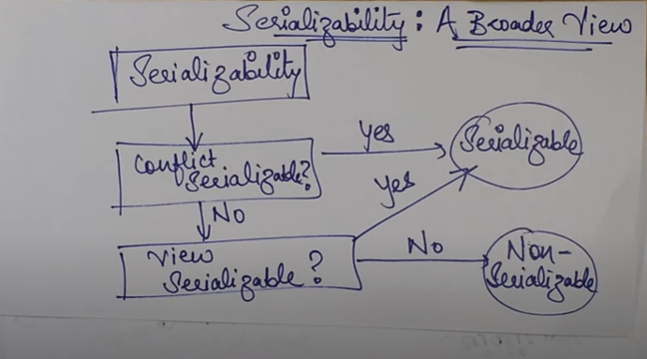

Slide 48
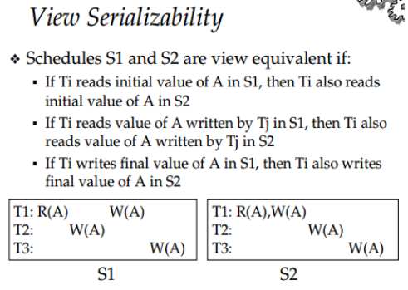


Slide 49
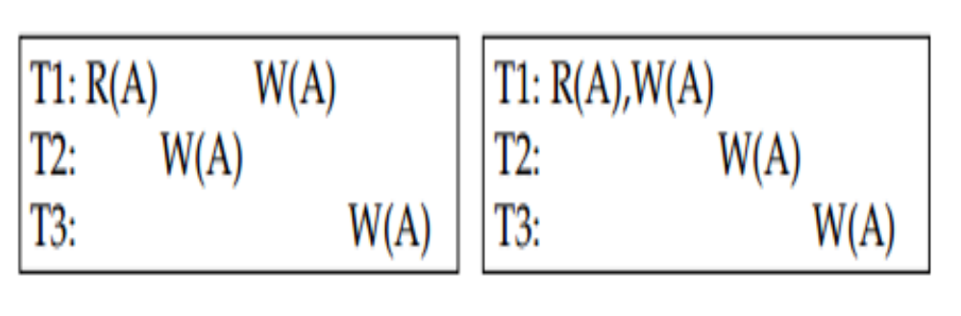
View Serializability

Slide 50

View Serializability (Cont.)
A schedule S is view serializable if it is view equivalent to a serial schedule.
Every conflict serializable schedule is also view serializable.
Below is a schedule which is view-serializable but not conflict serializable.
Every view serializable schedule that is not conflict serializable has blind writes.
Notes:
Compare this with T27, T28 and T29 serial schedule.

Slide 51
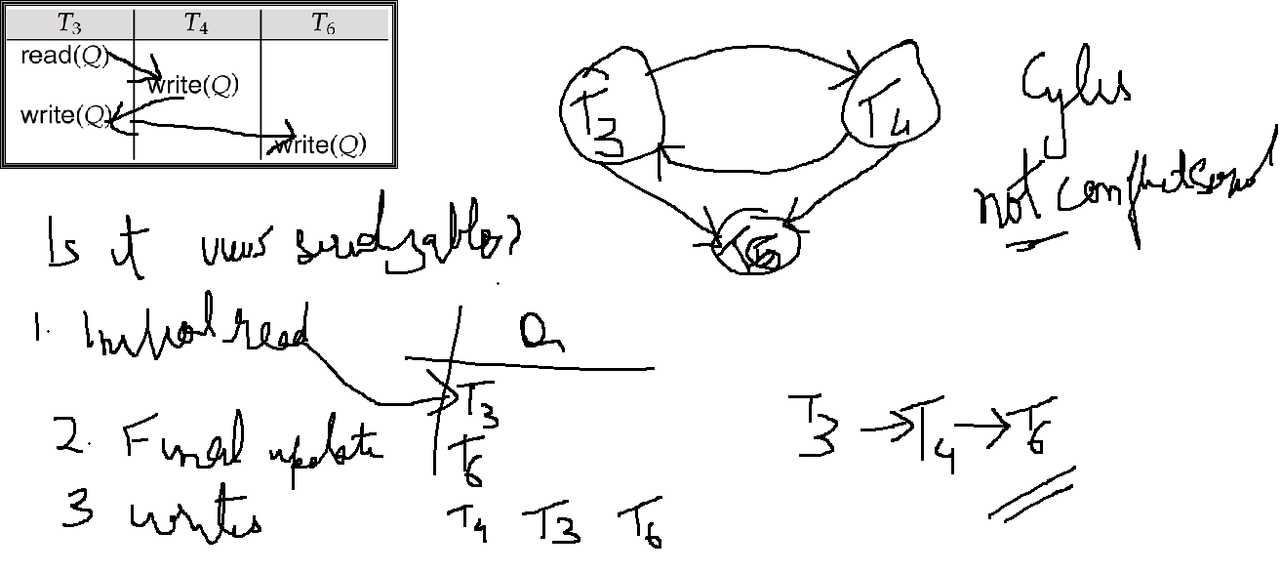
ex1

Slide 52
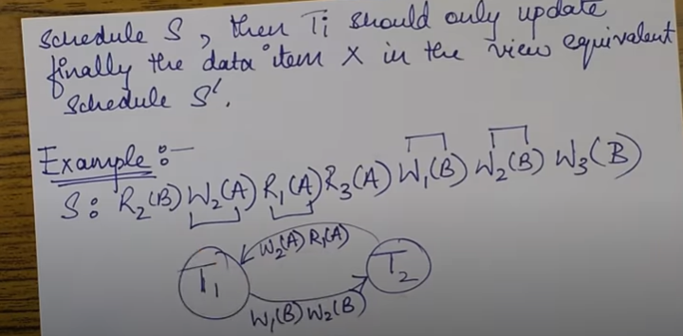
ex2

Slide 53
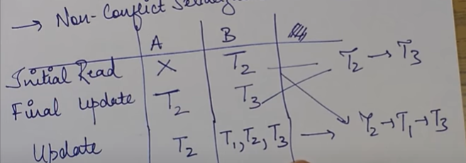

Slide 54
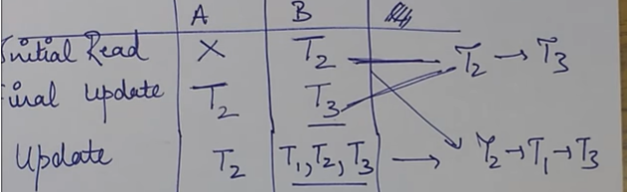

Slide 55
ex3
Example:
T1 T2
R(A)
R(A)
W(A)
R(B)
W(A)
R(B)
W(B)
Check for View serializable with <T1, T2> and <T2, T1>
Set of all Schedules
V.S.S
C.S.S
Notes:
It is not View serializable.

Slide 56
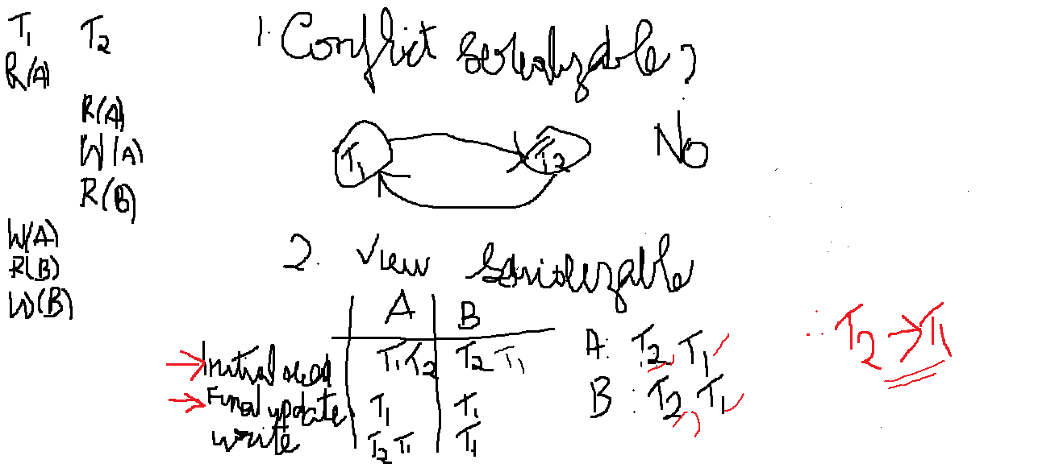

Slide 57
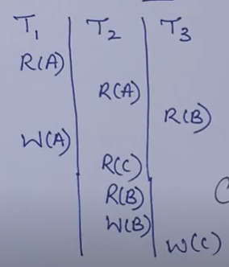
Ex4:no serializable schedule possible

Slide 58
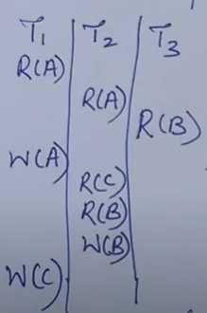
Ex5: Serialzable schedule possible

Slide 59
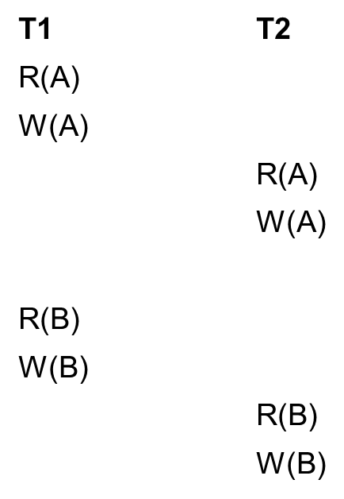
For student workout
Example: Check for View equivalence
Notes:
Ans: It is Conflict Serializable

Slide 60
T1 T2
R(A)
R(A)
W(A)
R(B)
W(A)
W(B)
Notes:
Ans: Not View Serializable

Slide 61
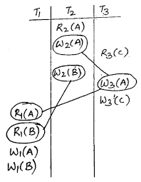

Slide 62
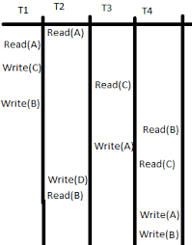

Slide 63
End of Chapter 14

Slide 64
Figure 14.01

Slide 65
Figure 14.02

Slide 66
Figure 14.03

Slide 67
Figure 14.04

Slide 68
Figure 14.05

Slide 69
Figure 14.06

Slide 70
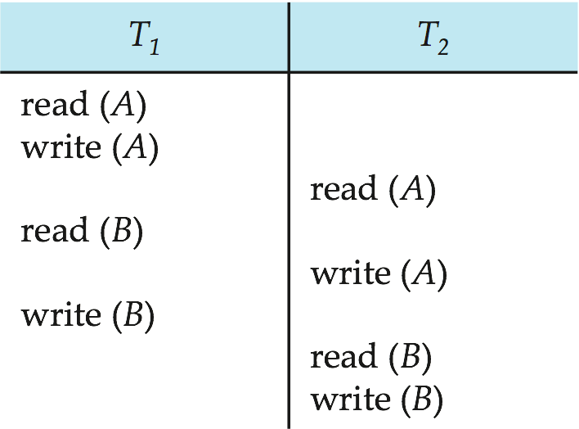
Figure 14.07

Slide 71
Figure 14.08

Slide 72
Figure 14.09

Slide 73
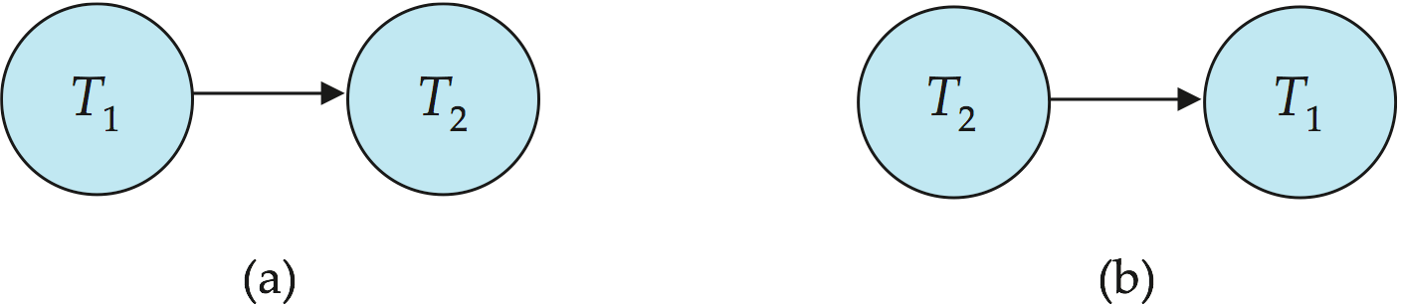
Figure 14.10

Slide 74
Figure 14.11

Slide 75
Figure 14.12

Slide 76

Figure 14.13

Slide 77

Figure 14.14

Slide 78

Figure 14.15

Slide 79
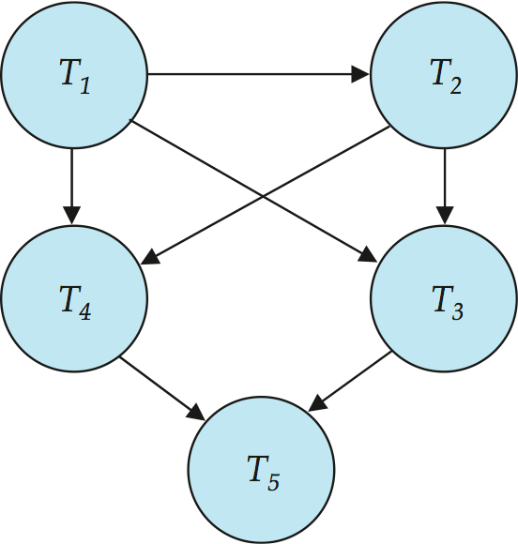
Figure 14.16

Slide 80
End of Chapter 14

Slide 81
Figure 14.01

Slide 82
Figure 14.02

Slide 83
Figure 14.03

Slide 84
Figure 14.04

Slide 85
Figure 14.05

Slide 86
Figure 14.06

Slide 87
Figure 14.07

Slide 88
Figure 14.08

Slide 89
Figure 14.09

Slide 90
Figure 14.10

Slide 91
Figure 14.11

Slide 92
Figure 14.12

Slide 93
Figure 14.13

Slide 94
Figure 14.14

Slide 95
Figure 14.15

Slide 96
Figure 14.16

